Slide 1



Steering Column/Pedal Position Control
(Manual Adjustment)
VSEM Id: F004690
Programs: U71x MY25
Feature Owner: Barry Maloney
FuSa Engineer: Ashish Keshri
Turn Around
Automotive Operations
Modernize Everywhere
Disrupt Ourselves

Slide 2
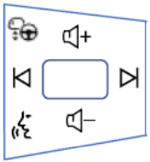
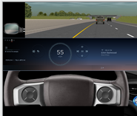
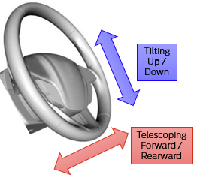
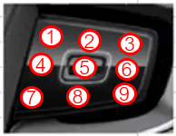
Steering Column Position Control on U71X
The "Steering Column Position Control" allows the user to make adjustment to the Steering Column Position (Tilt/Telescopic) using capacitive switch on the steering wheel when ignition is in Accessory/On position (e.g., while vehicle is stationary/driving).
Safety Goal: Prevent impaired access to steering controls (ASIL B)
Rationale: Significant change in steering column position without user intent while vehicle is driving may result in impaired access to steering control.
General flow for Column Pos Adjustment
1
Display Default Control
Display Driver
Adjust Control
Display Column Adjust
Touch?
2
3
4
Idle Timeout
Phoenix controls digital menu, contextual control and timeout
Hide Digital Switch
HMI System (Steering Horizon Control)
Steering Column System
Display Module
APIM_CDC
(Phoenix)
Driver Seat Module
(DSM)
Motor Signal
Column
Tilt Motor
Graphics info
Pos Info
ECG
Switch Module
SCCM, ECG
StewPosAdjTlt_D_Rq
StewPosAdjTel_D_Rq
Motor Signal
Column
Tele Motor
Pos
ASIL B
ASIL B
Pos Info

Slide 3
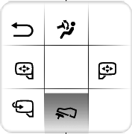
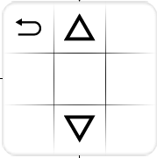
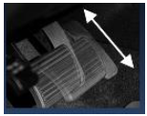
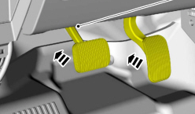
Pedal Position Control on U71X
The “Pedal Position Control" allows the user to make adjustment to the Pedal Position (Telescopic) using capacitive switch on the steering wheel when ignition is in Accessory/On position (e.g., while vehicle is stationary/driving).
Safety Goal: Prevent impaired access to pedal controls (ASIL B)
Rationale: Significant change in pedal position without user intent while vehicle is driving may result in impaired access to pedal control.
General flow for Pedal Pos Adjustment
1
Display Default Control
Display Driver
Adjust Control
Display Pedal Adjust
Touch?
2
3
4
Idle Timeout
Phoenix controls digital menu, contextual control state and timeout
Hide Digital Switch
HMI System (Steering Horizon Control)
Pedal Position System
Display Module
APIM_CDC
(Phoenix)
Driver Seat Module
(DSM)
Pedal Motor
ECG
Switch Module
SCCM, ECG
PdlAdj_D_Rq
ASIL B
ASIL B

